Slide 1
All you need to know about the NRCS levy
Cost , Categories, Registration, Data Submission and more
November 2025
SAMPA

Slide 2
Compulsory Levy
The payment of this levy is compulsory for all producers of Processed Meats that fall within the scope of VC9100
It is a requirement that producers register as levy payers with the NRCS and pay an annual levy registration fee
The levy fees for Processed Meat were published on 30th May 2025 and became effective on the same date
Bi annual production volumes must be submitted to the NRCS using their electronic portal , these volumes will be used to calculate levy fees due to the NRCS

Slide 3
VC9100
Compulsory specification for Processed Meat Products
VC9100 is a compulsory specification that applies to the handling, preparation, processing, packaging, refrigeration, freezing, chilling, labeling, marking and storage of heat treated and ready to eat(RTE) processed meat products covered in the scope of SANS 885:2011 & SANS 885:2022 and includes the microbiological and food safety related compositional requirements of these products
The classes of processed meat products are identified as heat treated and ready to eat (RTE) categorized in the respective classes and unspecified RTE product as listed in clause 5.3 SANS 885:2011 ( see next slide)

Slide 4
Product categories
A – Whole muscle, cured , heat treated products
B – Whole muscle, uncured, heat treated or partial heat treated and RTE products
C – Comminuted, cured, heat treated products
D – Comminuted, uncured and heat treated products
E – Reformed , cured and heat treated products
F – Unspecified class ( any unspecified RTE processed meat product)
G – RTE products which are not going to be cooked before consumption with the exclusion of dried and fermented processed meat products i.e. Salami

Slide 5
Levy Amount payable per category
Product Category | Cost per Unit | Unit volume
A | R60 | 1000kg
B | R60 | 1000kg
C | R30 | 1000kg
D | R30 | 1000kg
E | R30 | 1000kg
F | R30 | 1000kg
G | R60 | 1000kg

Slide 6
Levy Periods and Payment Cycle
There are two levy periods A & B
These may use the last two digits of the year -2025 =25A & 25B
A = January to June
B = July to December
In July (Levy period A) and January(Levy period B) vendors must submit their production data via the NRCS online portal. This on line system will calculate the amount due by the vendor.
The NRCS system will allow the vendor to self generate a tax invoice.

Slide 7
Levy Period and Payment Cycle
Vendors production data may be audited from time to time by the NRCS to validate data accuracy
Payment is due 30 days from date of invoice
Vendors will be audited in the event of any of the following:
Submitting a Nil return
Non Payment of amounts due
Business closure or change of ownership

Slide 8
Annual Levy Payer Registration
All vendors who produce processed meats that fall within the scope VC9100 must register on the NRCS vendor portal as levy payers
Vendors must complete form BF 16 – Annual Registration Form
Registration as a levy payer must be done annually.
The NRCS charge an annual registration fee each year
The registration fee in 2025 is R 1 751.00
Upon registration vendors will receive a customer number ( C12345) after which your area inspector will send you a PM Number
The PM Number or ( Establishment Number) must be printed as (Est NR: XYZ) onto on your product in such a way that it cannot be removed

Slide 9
Using the PM or Establishment number
The Establishment Number must be used on all products that fall within the scope of VC9100
The only exception when you do not have to show the Est NR on product packaging is when the packaging displays the following:
Full Name of the Manufacturer
Full Physical Address (Not a Postal or PO Box address)
For Imported products – a traceable form of the establishment registration number and the South African importer or re -packer name and address must be indicated.
The letter size shall comply with labelling regulations as per national legislation

Slide 10
Certificate of Compliance
Only once a facility has been inspected, products tested and all aspects of the VC have been met will the vendor be issued with an NRCS Compliance Certificate
Vendors holding FSSC 22 000 or other food safety certificates will have their processes inspected including those that have HACCP certificates as per R 908

Slide 11
NRCS - How to Guide
Go to https://www.nrcs.org.za/
On the NRCS homepage you must look for the rolling tape as indicated in the next slide.
Here you will find a tab for the How To Guide
Click on this tab to obtain all the information required for how to register, load vendor information, do levy submissions and generate invoices.

Slide 12
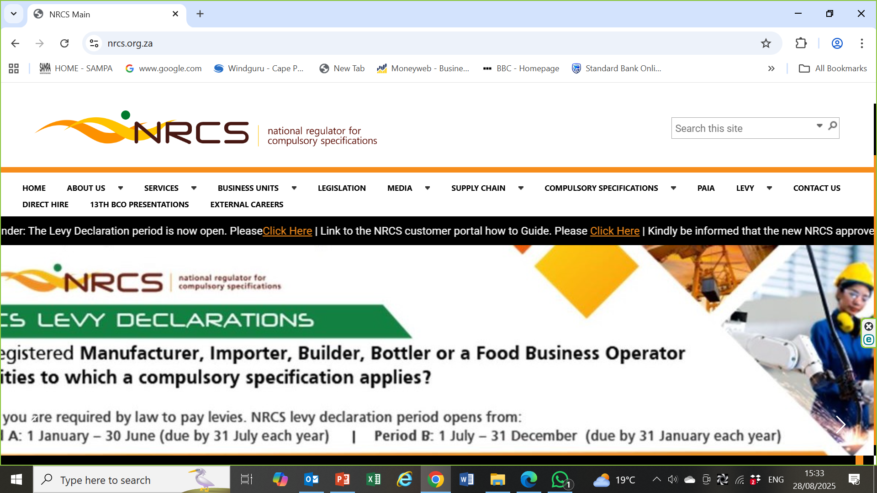
NRCS Website- How to Guide is found on the rolling tape
To access the NRCS website you can go to https://www.nrcs.org.za/

Slide 13
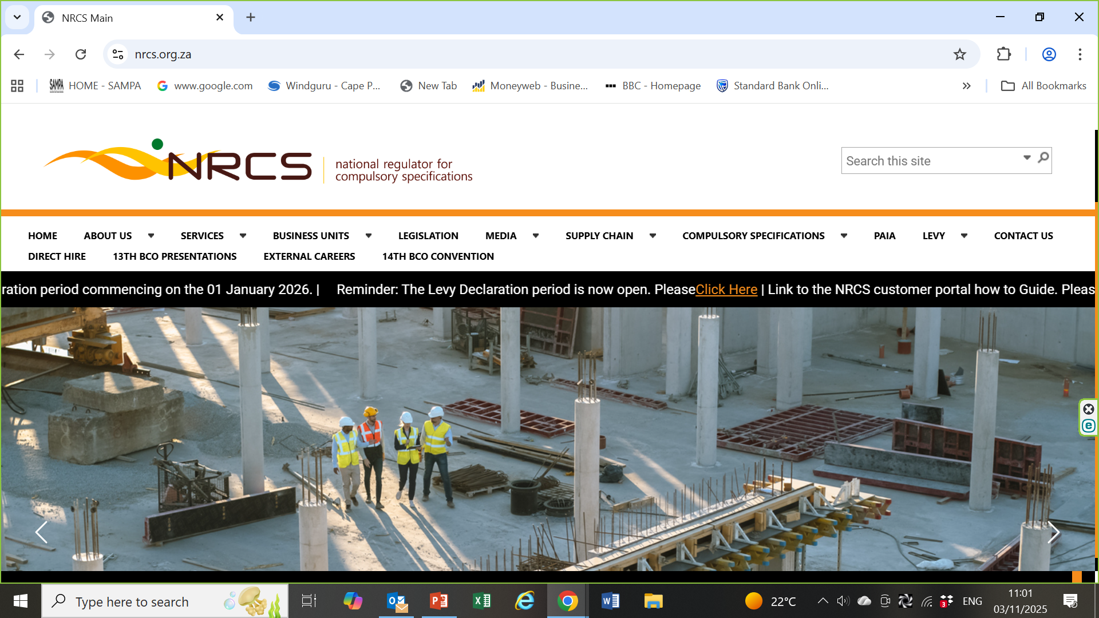
Levy Declaration Portal is found here

Slide 14
To Register as a levy payer or complete a Levy Declaration
Go to the NRCS homepage and look for the rolling tape that says -
“Reminder: The levy declaration period is now open. Please Click Here”
Here you can either Login using your unique email and password or register as new levy payer.
Once logged into the portal you must complete all 4 steps to complete data submission process.

Slide 15
Tax Invoice
Once you have inputted all your production volume onto the NRCS levy submission portal you will be able to self generate a tax Invoice on line.
The NRCS is not VAT registered. No VAT will be added to your invoice.
Under declaration of production volumes could result in a fine being issued and the NRCS conduction an audit of your production data.

Slide 16
SANS 885 Ed 4
Is SANS 885 Ed 4 available on the NRCS website or from SAMPA?
No, SANS 885 Ed 4 has to be purchased from the SABS webstore. Go to https://store.sabs.co.za/
You will first need to register with the SABS webstore and then purchase the document which will be downloaded via the email used to register with the SABS.
All SABS documents are copyright to the person buying the Standard.
The cost of SANS 885: 2022 Edition 4 in August 2025 was R 525.55

Slide 17
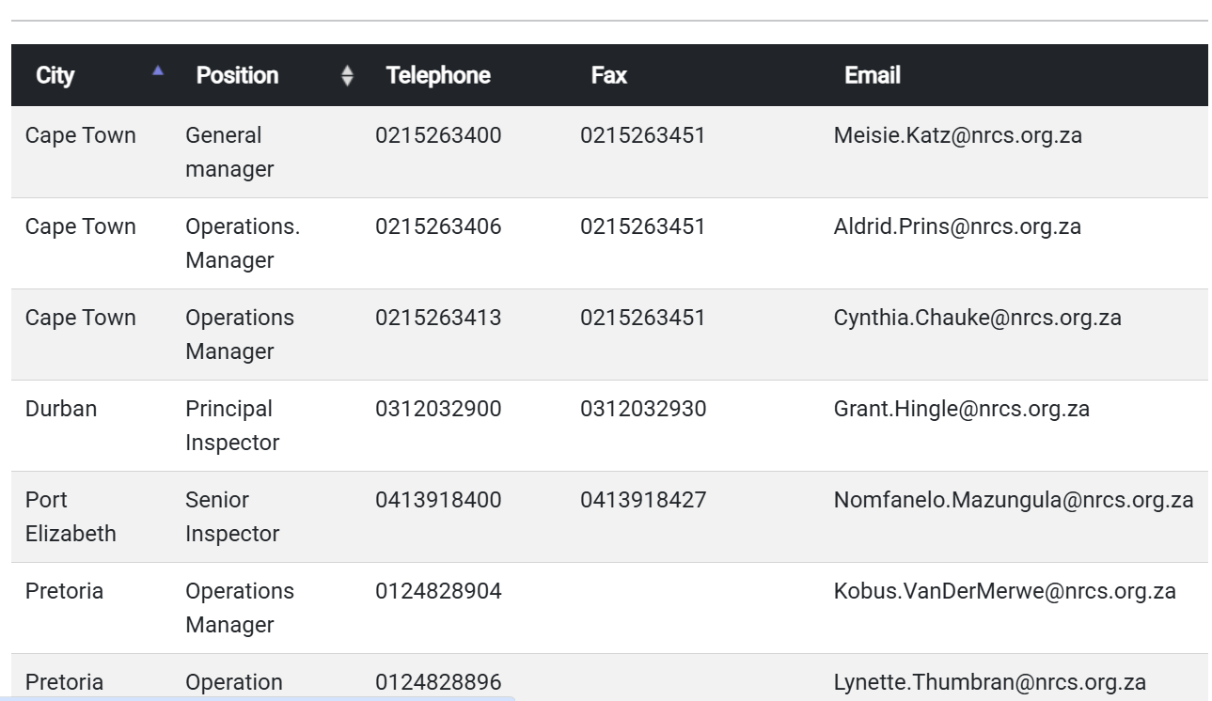
NRCS Contact List

