Slide 1
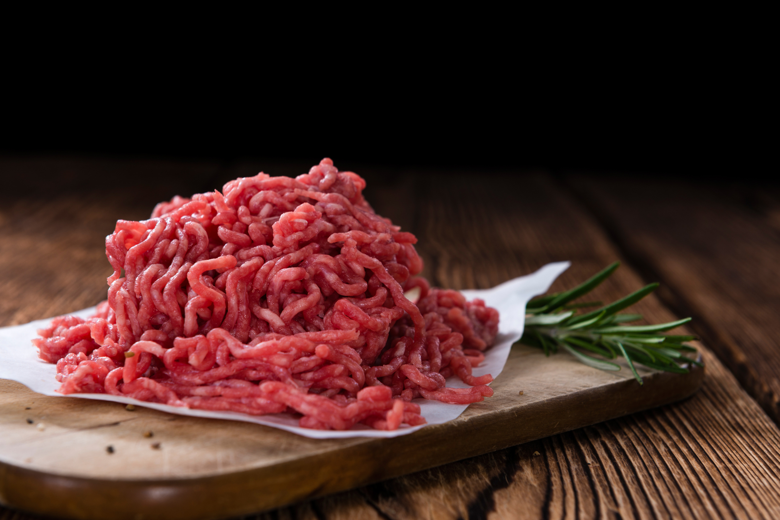
PROCESSED MEAT PRODUCTS & CERTAIN RAW PROCESSED MEAT PRODUCTS
R.1283, 04 October 2019 & R.2410, 26 August 2022
Presented by:
Palesa Mpana

Slide 2
Table of content
1. Categories and classes of Processed Meat Products (PMP) & Certain
Raw Processed Meat Products (RAW)
2. Definitions
3. Specific compositional standards
4. Marking of containers
5. Display Fridge
6. Restricted Particulars on containers and outer containers

Slide 3
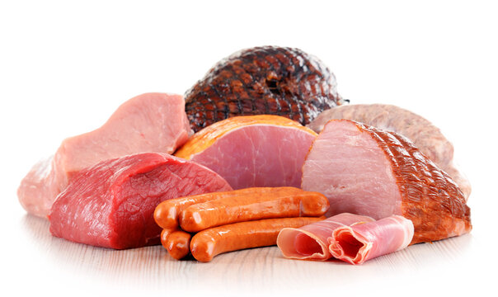
1. PMP CLASSES
SHALL BE CLASSIFIED AS FOLLOWS:
Whole muscle processed meat products
Comminuted processed meat products
Reformed processed meat products
Coated processed meat products
Unspecified processed meat products
Geographical Indication (GI) processed meat products

Slide 4
2. PMP DEFINITIONS
Whole muscle processed meat product: Means a meat product with whole muscle still intact and which might have been subjected to a process resulting in protein extraction and might, in addition, have been placed into a mold to shape the product;
Comminuted processed meat products: Means a product comprising of meat pieces that have been reduced in size by either mincing, grinding, chopping, flaking, dicing or emulsifying, with or without other ingredients, which is then either filled into a casing, formed into a mold or preformed;
Reformed processed meat products: Means a product of which the individual visible meat pieces are no smaller than 13mm, with or without the addition of finely comminuted meat and other permitted ingredients, of which the soluble protein bind the meat pieces together and upon cutting,, has the typical appearance of meat muscle;
Coated Processed Meat Products: Means a product of which the surface has been covered with a pre-dust, batter or breading or any combination thereof.

Slide 5
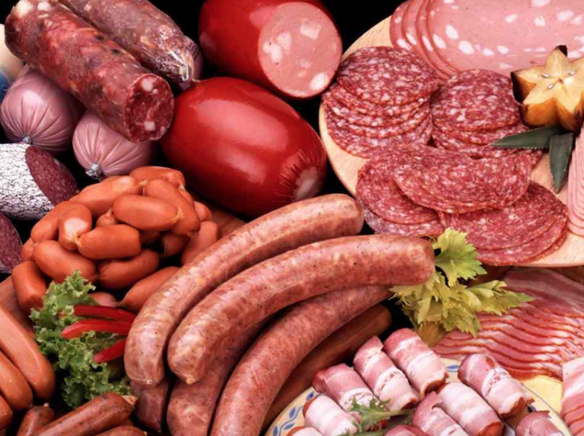
COMPOSITION
SPECIFIC COMPOSITIONAL STANDARDS PMP
Regulation 6(1)
5. (1) All classes of whole muscle processed meat products -
(a) shall contain no added pork rinds
(b) shall contain no added gelatin
(c) shall contain no added defeathered skin
(d) shall contain no mechanically recovered meat
(e) may contain bone, rind, show pieces, batter or crumbs
(f) maybe smoked or unsmoked as well as cured or uncured
(g) shall comply with the compositional specifications as set out

Slide 6
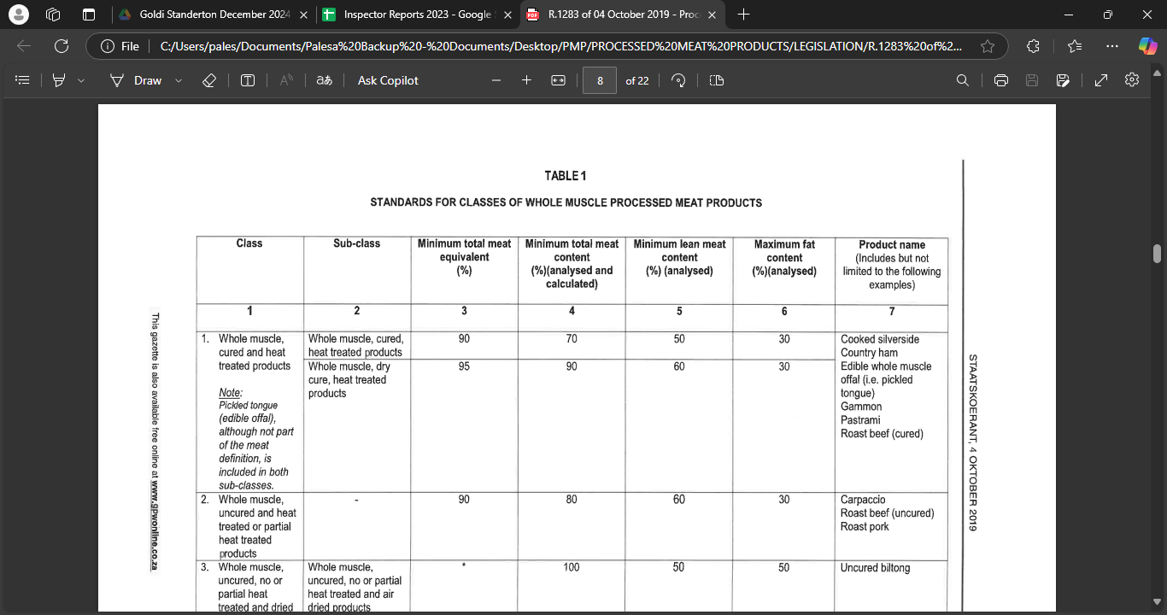

Slide 7
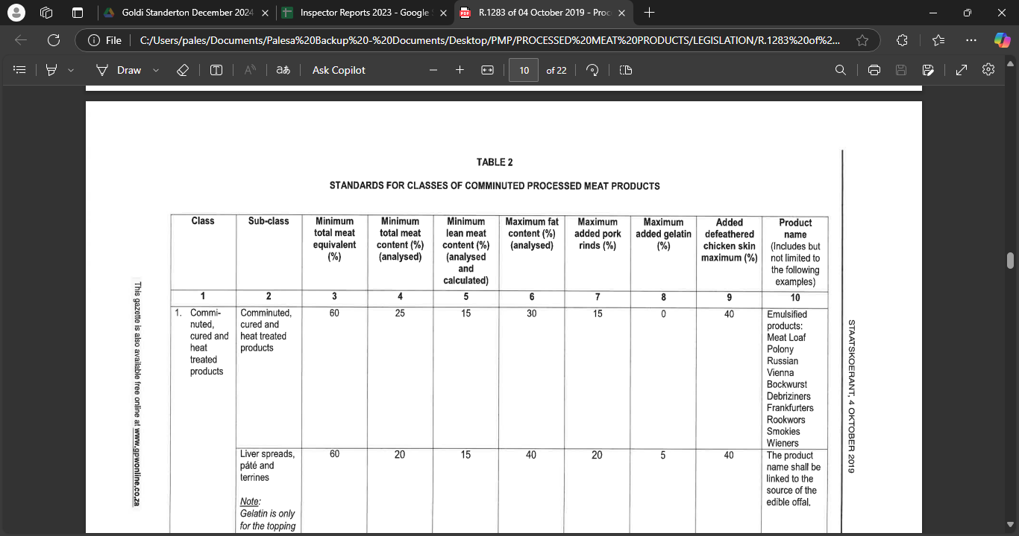

Slide 8
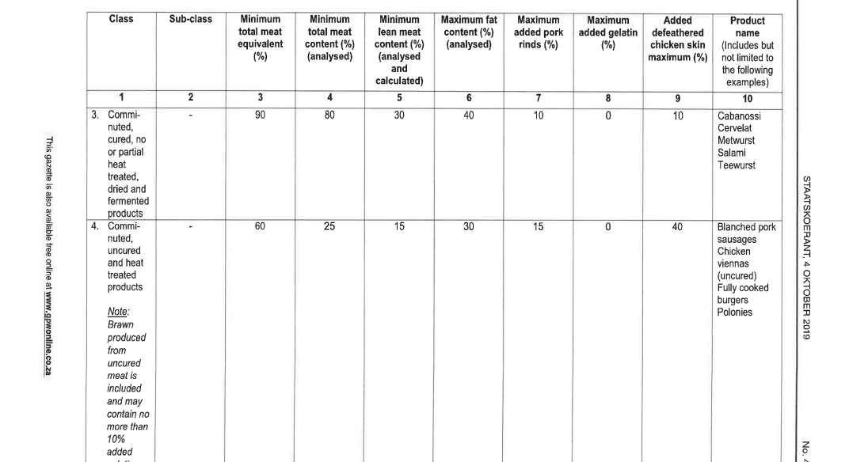
COMPOSITION

Slide 9
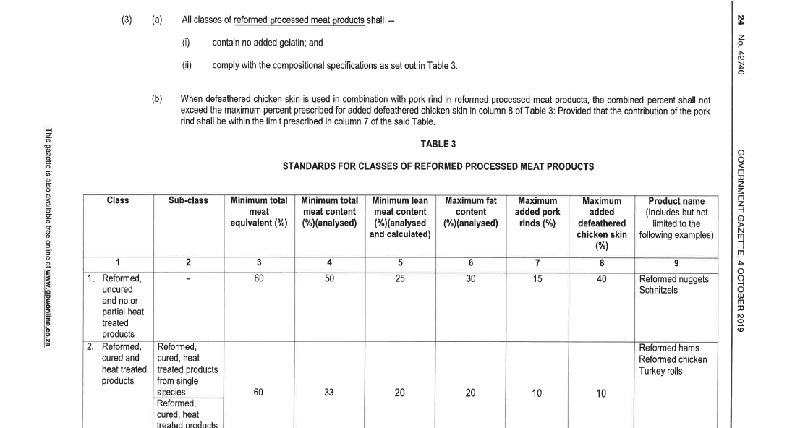

Slide 10
COMPOSITION
SPECIFIC COMPOSITIONAL STANDARDS PMP
Regulation 6(4)

Slide 11
COMPOSITION

Slide 12
RAW CLASSES
SHALL BE CLASSIFIED AS FOLLOW:
(a) Raw Minced Meat
(b) Raw mixed-specie minced meat
(c) Raw flavoured ground meat or Raw flavoured minced mix or Raw flavoured meat mix.
(d) Raw flavoured ground meat and offal or Raw flavoured minced and offal mix or Raw flavoured meat and offal mix.
(e) Raw flavoured mixed-species ground meat or Raw flavoured mixed-species minced mix or Raw flavoured mixed-species meat mix.
(f) Raw flavoured mixed-species ground meat and offal or Raw flavoured mixed-species minced, and offal mix or Raw flavoured mixed-species meat and offal mix.
(g) Raw boerewors.
(h) Raw species sausage or Raw species wors.
(i) Raw mixed-species sausage or Raw mixed-species wors.
(j) Raw burger, Raw patty and Raw hamburger patty.
(k) Raw banger or Raw griller.
(l) Raw braaiwors or Raw sizzler.
(m) Geographical Indication (GI) raw processed meat products.

Slide 13
1. DEFINITIONS
Domesticated animal specie: Species such as bovine, ovine, porcine, and caprine that are fit for human consumption
Meat: Means the clean, sound and wholesome skeletal musculature and fatty tissues of any domesticated animal, bird or wild game
Raw braaiwors or raw sizzler: Any sausage sold under a name in which the word “braaiwors” or “sizzler” appears, either by itself or in combination with any other word or expression
Raw species sausage or raw species wors: Any sausage manufactured predominantly from the meat of a specific species of domesticated animals, birds or wild game and that is sold under a name in which the name of the specific species and the word “sausage” or “wors” appear, either by itself or in combination with any other word or expression.
Total Meat Content: Lean meat percent (including mechanically recovered meat, except where it is specifically excluded, plus fat percent

Slide 14
COMPOSITION
SPECIFIC COMPOSITIONAL STANDARDS
Regulation 5(1)-(2)
5(1) Raw minced meat (single domesticated animal, bird or wild game species)
5(2) Raw mixed-species minced meat (mixture of finely chopped or comminuted meat from two or more domesticated animal, bird and/or wild game species)
Fat content claim | Fat content (%) (as analysed)
Extra lean, Extra trim, Extra Trimmed of fat, or any similar wording | ≤5
Lean, Trim or Trimmed of fat, or any similar wording | >5 to ≤10
Regular, or any similar wording | >10 to ≤30; and

Slide 15
COMPOSITION
SPECIFIC COMPOSITIONAL STANDARDS
Regulation 5:
(3) Raw flavoured ground meat or Raw flavoured minced mix or Raw flavoured meat mix
Total Meat Content (%) | Fat content (%) | (d) shall contain no edible offal; (e) shall contain no mechanically recovered meat; (f) may contain colourants and/or food additives; and (g) may contain added water
Minimum of 75 % | No more than 30 % | (d) shall contain no edible offal; (e) shall contain no mechanically recovered meat; (f) may contain colourants and/or food additives; and (g) may contain added water

Slide 16
COMPOSITION
SPECIFIC COMPOSITIONAL STANDARDS
Regulation 5:
(7) Raw boerewors:
(a) shall be manufactured from the meat of a domesticated animal of the bovine, ovine, porcine or caprine species, or from a mixture of two or more thereof;
Total Meat Content (%) | Fat content (%) | (b) shall be contained in an edible casing - may be offal (f) shall contain no mechanically recovered meat; (g) shall contain no colourants; (h) shall contain no added ingredients other than – (i) cereal and/or starch; (ii) vinegar, spices, herbs and/or salt; (iii) food additives; and (iv) water
Minimum of 90 % | No more than 30 % | (b) shall be contained in an edible casing - may be offal (f) shall contain no mechanically recovered meat; (g) shall contain no colourants; (h) shall contain no added ingredients other than – (i) cereal and/or starch; (ii) vinegar, spices, herbs and/or salt; (iii) food additives; and (iv) water

Slide 17
COMPOSITION
SPECIFIC COMPOSITIONAL STANDARDS
Regulation 5:
(8) Raw species sausage or Raw species wors:
(a) shall be manufactured totally or predominantly from the meat of a specific domesticated animal, bird or wild game species;
Total Meat Content (%) | Fat content (%) | (e) shall be contained in an edible casing - may be offal (f) shall contain no mechanically recovered meat; (g) shall contain no colourants; (h) shall contain no added ingredients other than – (i) cereal and/or starch; (ii) vinegar, spices, herbs and/or salt; (iii) food additives; and (iv) water
≤75% of predominant specie (Mentioned in product name) | No more than 30 % | (e) shall be contained in an edible casing - may be offal (f) shall contain no mechanically recovered meat; (g) shall contain no colourants; (h) shall contain no added ingredients other than – (i) cereal and/or starch; (ii) vinegar, spices, herbs and/or salt; (iii) food additives; and (iv) water

Slide 18
COMPOSITION
SPECIFIC COMPOSITIONAL STANDARDS
Regulation 5:
(10) Raw burger, raw patty and raw hamburger patty:
(a) shall be manufactured from chopped or comminuted meat of a domesticated animal, bird or wild game species, or from a mixture of two or more thereof, and formed into a round, square or any other shaped patty; and
(b) shall comply with the following compositional specifications for the category/name concerned:

Slide 19
COMPOSITION
Regulation 5(10):
Category/ Product Name | Permissible ingredients | Fat content claim | Fat content (%) (as analysed) | Total meat content (%)
1, Ground Burger/ Ground Patty | Shall be manufactured from meat only. Shall contain no edible or inedible offal, or any other added ingredients. | Extra Lean, Extra Trim, Extra trimmed of fat or any similar wording Lean, Trim, Trimmed of fat or any similar wording Regular | ≤5 >5 to ≤10 >10 to ≤30 | ≥99.6
2. Burger/ Patty/ Hamburger Patty/ Meatball/ Frikkadel | Shall contain no added ingredients other than – cereal and/or starch; vinegar, spices, herbs and/or salt; food additives; and water. Shall contain no edible or inedible offal. Shall contain no mechanically recovered meat. Shall contain no colourants. Shall contain no vegetable protein. May contain other foodstuffs | Extra Lean, Extra Trim, Extra trimmed of fat or any similar wording Lean, Trimmed of fat or any similar wording Regular | ≤5 >5 to ≤10 >10 to ≤30 | ≥70

Slide 20
COMPOSITION
Regulation 5(10):
Category/ Product Name | Permissible ingredients | Fat content claim | Fat content (%) (as analysed) | Total meat content (%)
3. Value burger/ Value patty/ Value hamburger/ Value meatball/ Value frikkadel/ Any other similar name | Shall contain no added ingredients other than – cereal or starch and/or vegetable protein; vinegar, spices, herbs and/or salt; food additives; and water. Shall have a minimum total meat equivalent of 60 percent. Shall contain no inedible offal. May contain – mechanically recovered meat; edible offal; colourants; and other foodstuffs | *No Specification | ≤30 | ≥55

Slide 21
COMPOSITION
Regulation 5(10):
Category/ Product Name | Permissible ingredients | Fat content claim | Fat content (%) (as analysed) | Total meat content (%)
4. Economy Burger/ Econo Burger/ Economy Patty/ Econo Patty/ Budget Burger/ Econo Hamburger patty/ Budget Hamburger patty/ Econo meatball/ Econo frikkadel/ Any other similar name | Shall contain no added ingredients other than – cereal or starch and/or vegetable protein; vinegar, spices, herbs and/or salt; food additives; and water. Shall have a minimum total meat equivalent of 55 percent. Shall contain no inedible offal. May contain – mechanically recovered meat; edible offal; colourants; and other foodstuffs. | *No Specification | ≤30 | ≥35

Slide 22
COMPOSITION
SPECIFIC COMPOSITIONAL STANDARDS
Regulation 5:
(11) Raw banger or raw griller:
(a) shall be manufactured from single or any mixture of the meat of two or more domesticated animal, bird or wild game species;
Total Meat Equivalent (%) | Fat content (%) | Total meat content (%) | (b) shall be contained in an edible casing - may be offal (g) shall contain no mechanically recovered meat; (h) shall contain no added ingredients other than – (i) cereal and/or starch; vegetable protein (ii) vinegar, spices, herbs and/or salt; (iii) food additives; (iv) water; and may contain colourants; and (j) may contain other foodstuffs.
Minimum of 60% | Maximum of 30 % | Minimum of 40% | (b) shall be contained in an edible casing - may be offal (f) shall contain no mechanically recovered meat; (g) shall contain no colourants; (h) shall contain no added ingredients other than – (i) cereal and/or starch; (ii) vinegar, spices, herbs and/or salt; (iii) food additives; (iv) water; and (i) may contain other foodstuffs.

Slide 23
COMPOSITION
SPECIFIC COMPOSITIONAL STANDARDS
Regulation 5:
(12) Raw braaiwors or Raw sizzler:
(a) shall be manufactured either from the meat of a single domesticated animal, bird or wild game species, or from a mixture of two or more of such species;
Total Meat Equivalent (%) | Fat content (%) | Total meat content (%) | (b) shall be contained in an edible casing - may be offal (g) shall contain no mechanically recovered meat; (h) shall contain no added ingredients other than – (i) cereal and/or starch; (ii) vinegar, spices, herbs and/or salt; (iii) food additives; (iv) water; and may contain colourants; and (j) may contain other foodstuffs.
Minimum of 60% | Maximum of 30 % | Minimum of 40% | (b) shall be contained in an edible casing - may be offal (f) shall contain no mechanically recovered meat; (g) shall contain no colourants; (h) shall contain no added ingredients other than – (i) cereal and/or starch; (ii) vinegar, spices, herbs and/or salt; (iii) food additives; (iv) water; and (i) may contain other foodstuffs.

Slide 24
COMPOSITION

Slide 25
Marking Requirements
Marking of containers and outer containers PMP & RAW
Each container and outer container containing raw processed meat products shall be clearly and legibly marked directly on the container or on the label attached thereto and at least in English with the following particulars:
The appropriate product name – Dependent on the composition
The additions to the appropriate product name where applicable.
The name and address of the manufacturer, packer, importer, seller or person or entity on whose behalf the product has been packed.
The date marking (i.e. "best before" or "best quality before" or "use by" or "expiration" date) or batch code or batch number, for the purpose of traceability and batch identification.
The country of origin, provided that products originating from two or more countries are packed in an outer container, all the countries of origin shall be declared on such outer container.

Slide 26
Marking Requirements
PMP Appropriate product name
As specified in regulation 9, prominently on the main panel in letters of the same type, colour and font, and on a contrasting background in a letter size of at least 3 mm:
Regulation 9 (b): Where necessary, the product name shall also include a description about but not limited to the style, cut, physical condition, type of treatment it has undergone, type of packing medium, etc: Provided that the descriptors sole purpose shall be to assist the consumer in making an informed decision about the product and to avoid any possible misleading or confusion about its true nature.

Slide 27
Marking Requirements
RAW Appropriate product name
As specified in regulation 8, prominently on the main panel in letters of the same type, colour and font, and on a contrasting background in a letter size of at least 3 mm:

Slide 28
Product Name
Indicating the appropriate products name
Regulation 8:
The product name shall at least consist of the appropriate product name for the class concerned (5): Provided that in the case where meat from:
A single specie is used, the name of the specie shall form part of the product name.
Two or more species are used, be named in descending order of mass.
Collective name “game” or “venison” may be used where applicable.
Edible offal my be listed (e.g., heart, liver etc.) or collective name “offal”.
The word “raw” may be omitted.
The word “minced” may be substituted by the word “mince”.
No word or expression may be bigger than the product name unless:
It is a registered trademark or brand name
Promotion (limited period of 12 months) e.g., “new”, “try me”, “on sale”, etc.
The price of the product

Slide 29
Additions
Additions to the appropriate product name
If a flavouring has been added to a product the product name shall either be preceded by the expression “X Flavoured” or followed by the expression “with X Flavour” or “with X Flavouring” e.g., Chakalaka Flavouring / with Chakalaka Flavour etc.
If a foodstuff has been added to a product the name shall be followed or preceded by the expression “with X” or wording having a similar meaning, where “X” indicates the generic name(s) of the foodstuff(s) added e.g., Mutton sausage with chilli / Chilli Mutton sausage etc.
Words communicating the intended use or purpose of the raw processed meat product concerned may optionally be indicated, and may either form part of the product name, or may be indicated on its own on the container (or both), e.g. breakfast sausage, etc.
The fat content claims prescribed in the case of the classes raw minced meat and raw mixed-species minced meat, shall form part of the appropriate product name and/or be indicated on its own on the main panel: Provided that the fat content claim “regular” may be omitted.

Slide 30
Additions
Additions to the appropriate product name
Regulation 9:
The fat content claims prescribed in the case of the categories of raw burger, raw patty and raw hamburger patty may form part of the appropriate product name and/or be indicated on its own on the main panel: Provided that the fat content claim “regular” may be omitted.
If a specific cut of meat of carcass (e.g. steak or topside or breast) is solely used to manufacture raw minced meat and raw mixed-species minced meat the appropriate product name may be followed or preceded by the name of the specific cut of meat e.g. Steak minced meat or Topside minced meat, etc. – and shall still meet the compositional requirements.
In the case of the categories of the classes for burger, patty and hamburgers, the words “sizzler” or “griller” may be used in combination with the word “burger” or “patty” or “hamburger patty”. – and shall still meet the compositional requirements.

Slide 31
Identification
Batch Identification
Regulation 10:
For the purpose of traceability and batch identification each container containing a raw processed meat product shall be clearly marked with the batch code or batch number or date marking in such a way that the specific batch is easily identifiable and traceable and shall not be removed or altered
If a date marking appears on the container it may serve as the batch code
If product are packed in an outer container which will be discarded by the consumer, the batch code shall appear on each individual container retained by the consumer until consumption.

Slide 32
Originality
Country of Origin
The country of origin shall be declared as follows on every container:
"Product of (name of country)" if all the main ingredients, processing and labour used to make the product are from one specific country;
"Produced in (name of country)", "Processed in (name of country)", "Manufactured in (name of country)", "Made in (name of country)", or wording having a similar meaning, when the product is processed in a second country which changes its nature; or
The words "Packed in (name of country)" may be used in addition to the requirements of sub-regulation (1)(a) or (b).

Slide 33
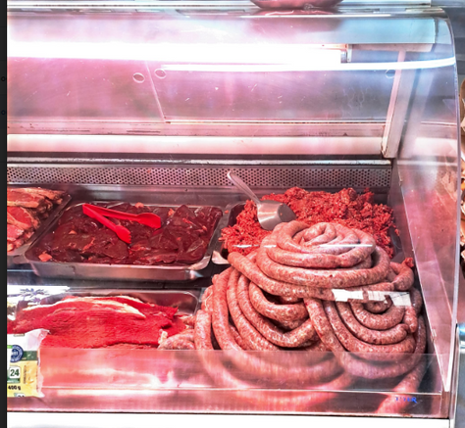
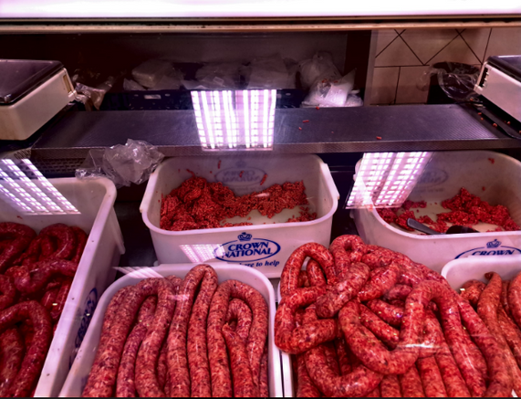
Display
Raw Processed Meat Products Presented for sale in a
Display Fridge
Regulation 12:
When sliced, cut or whole raw processed meat products are displayed for sale in for example a deli display fridge or counter, the appropriate product name shall be indicated conspicuously in the immediate vicinity of each class of raw processed meat product concerned.

Slide 34
Restricted Particulars
Restricted particulars on containers and outer containers
Only the appropriate product name concerned shall be marked on a container.
No word, mark, illustration, depiction or other method of expression that constitutes a misrepresentation or directly or by implication creates or may create a misleading impression regarding the quality, nature, class, origin or composition of a product. E.g. Cannot say “Premium boerewors” or “Exceptional boerewors”
No claim regarding the absence of any substance that does not normally occur in a particular class of raw processed meat products shall be marked on the container or outer container thereof except in cases where it is allowed for in the regulations published under the Foodstuffs, Cosmetics and Disinfectants Act, 1972 (Act No. 54 of 1972).

Slide 35
THANK YOU
Any Questions?

