Slide 1
PRESENTED BY
DEWALD OLIVIER
Future
SHAPING OUR

Slide 2
ESTIMATED
POTENTIAL RED MEAT SECTOR GROWTH OF
R12 BILLION
250 000 additional weaner calves targeted from these producers over the next 10 years

Slide 3
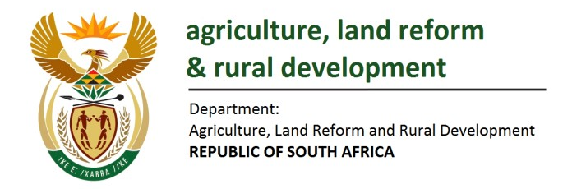
Industry alignment with Government
OPPORTUNITIES
The Agriculture and Agro-Processing Master Plan (AAMP)
Red Meat Strategy 2030
National Development Plan

Slide 4
FOUR STRATEGIC FOCUS AREAS
ANIMAL & PUBLIC HEALTH
INCLUSIVE GROWTH
MARKET ACCESS
COMPETITIVENESS AND SUSTAINABILITY

Slide 5
RED MEAT STRATEGY
2030
250 000 additional weaner calves in the commercial value chain
Implement a Livestock Identification and Traceability System for Beef
A Credible National Animal Health Model
Growing the export market by 20%
Meat/Product Safety – Inspections & compliance at all sections in the value chain

Slide 6
2024 RMIS PROJECTS
Recordkeeping Systems Communication & Data Sharing (Traceability)
Small Scale Farmer Development
(LDS Project)
Mobile Cattle Processing Units for Small-scale Farmers
Small-scale Farmer Training
Sharing relevant traceability and production data in a standardised language
Commercialisation of small-scale farmers through practical implementation and mentorship
Improving accessibility of comprehensive animal processing for small-scale farmers.
17 different training courses covering all aspects of red meat primary production
19% (R7 000 000)
Project is Self-Funded
8% (R3 000 000)
14% (R5 400 000)
Animal Disease Recording System and Vet Support Services
Research & Development
Capturing, analysing, and sharing veterinarian data on national disease occurrence to provide proactive treatment approaches
Various R&D projects including implementing a beef grading system
10% (R3,700,000)
8% (R3 300 000)

Slide 7
2024 RMIS PROJECTS
Feedlot Market in FMD Red Zone
Industry Meat Safety Recording System and Vet Support Services
SA Red Meat Certification
Stock Theft
Create a feedlot market in the red zone to limit cattle movement out of the area
Capturing & sharing national meat safety data to address compliance concerns
Value chain certification for meat sold to consumers ensuring meat safety
Training to combat livestock theft & addressing cases to enhance prosecution of offenders
5% (R2 000 000)
10% (R4 000 000)
12% (R4 700 000)
5% (R2 000 000)
Production Development through Communication
Consumer Communication & Education: Beef & Lamb
Communication to primary producers to increase production, competitiveness, and sustainability
Promoting red meat consumption among consumers by providing scientific and industry feedback.
9% (R3 400 000)
2% (R700 000)

Slide 8
TRACEABILITY
Create and facilitate a data-sharing platform to enable different systems and participants to share data for specific requirements (such as traceability) and introduce standardized data language
Create Industry Championed Traceability Solution
2024 PROJECT
TRUST
Trust is the basis of participation
Farmers and other value chain clients already have trust in their recordkeeping service provider
OPTIONS
Provision of options based on preference and utility
Provide participants with service provider and tagging options
DATA UTILITY
Transparency of data utilization and risk mitigation towards data sharing
The decentralization of data and restricted/dedicated authorization

Slide 9
SMALL-SCALE FARMER TRAINING
Provide comprehensive training to farmers through:
Credit/Non-Credit Bearing Training Courses
Farmer’s Days
Study Group Sessions
Individual Farm Visits
2024 PROJECT
covering production systems, reproduction and breeding, herd health, veld and pasture, management, finances, and marketing.
Content development for secondary agricultural school students
in collaboration with the Department of Education

Slide 10
MOBILE PROCESSING UNIT
Equipped with scale, neck clamp and various animal handling tools
ASSISTING SMALL SCALE FARMERS WITH
2024 PROJECT
Tagging and Branding
Dehorning
Vaccinations (Internal Parasite Control)
Dipping (External Parasite Control)
Basic Disease Treatment
Focusing efforts at dip tanks and also assisting on other projects such as the DALRRD Land Development Support Programme

Slide 11
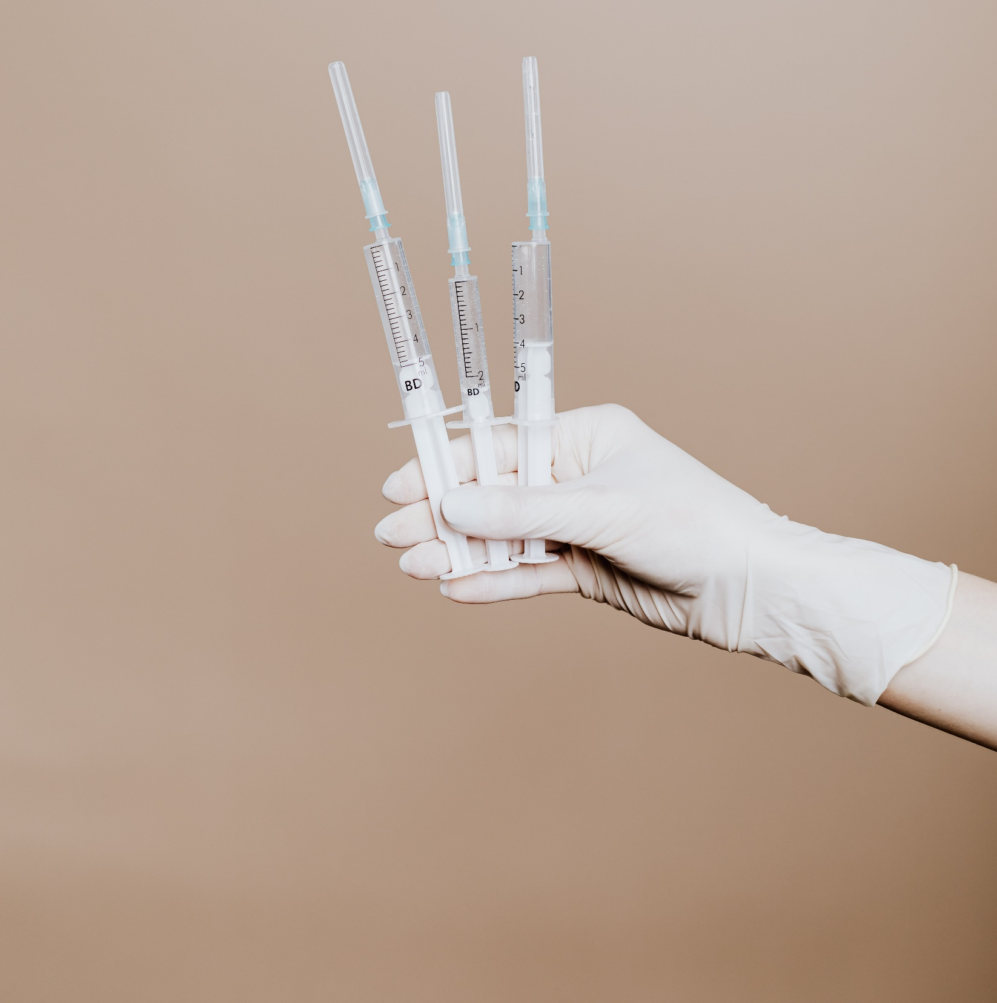
2024 PROJECT
Animal Disease Recording System
Vet Support Services
An application for veterinarians to capture data on the prevalence of diseases in their area, to get the overall national view in order to provide proactive treatment approaches

Slide 12
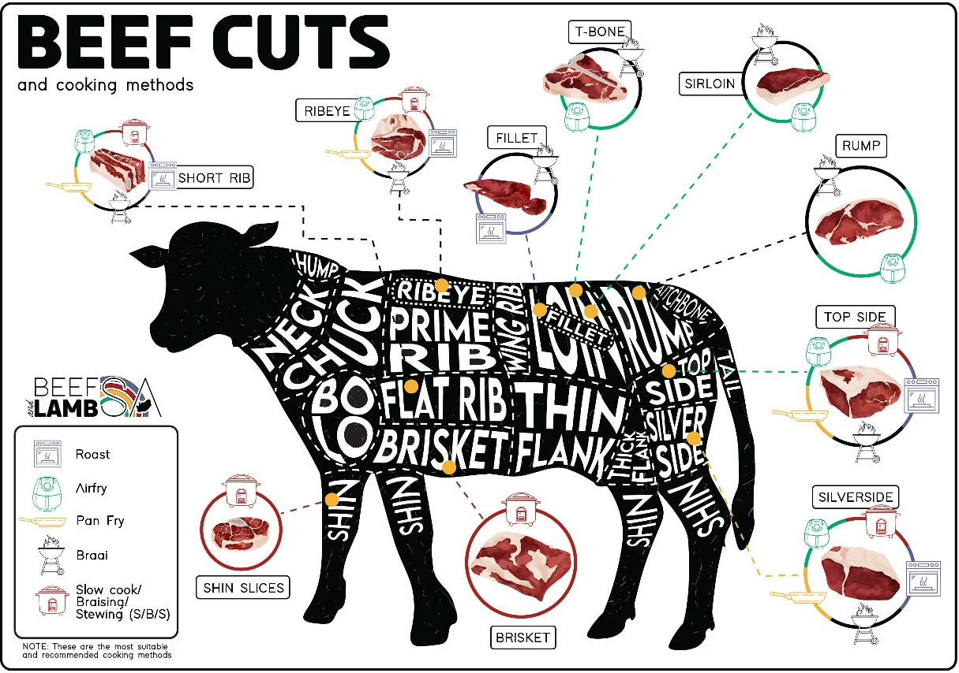
CONSUMER EDUCATION BEEF & LAMB SA
2024 PROJECT
www.beefandlambsa.com

Slide 13
SA RED MEAT CERTIFICATION
Providing a value chain certification for meat sold to consumers to ensure biosecurity, animal welfare, and meat safety through a value chain audit process, thereby enhancing market access and export opportunities.
2024 PROJECT

Slide 14
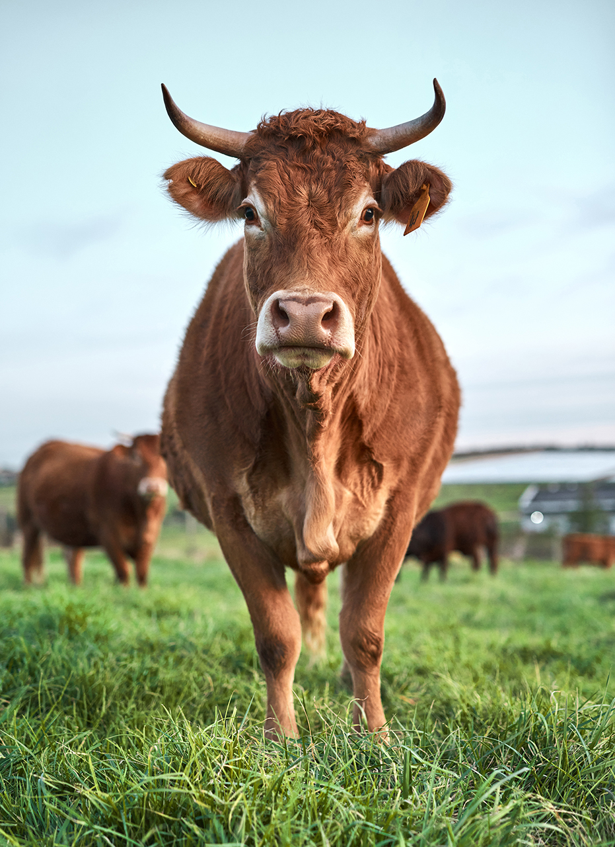
CURRENT STATE OF THE INDUSTRY
Key statistics
Production volumes
- 2,4 million cattle slaughtered
- 5,5 million sheep carcasses to the South African and International market
The market to China has also reopened after a recent visit by a delegation from the People’s Republic of China
Market share
- 14th largest producer globally

Slide 15
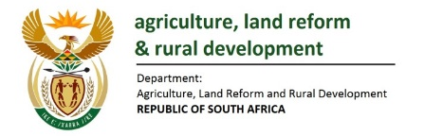
SA RED MEAT INDUSTRY PROFILE
FORMAL: 12.3M
INFORMAL: 5.69M
TOTAL: 17,99M
Annual slaughter
FORMAL: 2.6M
INFORMAL: 1,3M
520 000 Grazing System
(20% of formal)
1,065M ton consumed
1,08M ton produced
4.2%
30 000t export market
95,8%
670 000t internal market
18,12 kg consumption per capita
98 M ha of pasture
7 ha/head
280 kg average carcass weight male
2,08M Grain
Fed System
(80% of formal)
270 kg average carcass weight female
850 000 Head one time capacity
130 Standing Days
#1 Kuwait (22%)
#2 Jordan (16%)
#3 Mozambique (13%)
SOURCE: Department of Agriculture, Land Reform and Rural Development

Slide 16
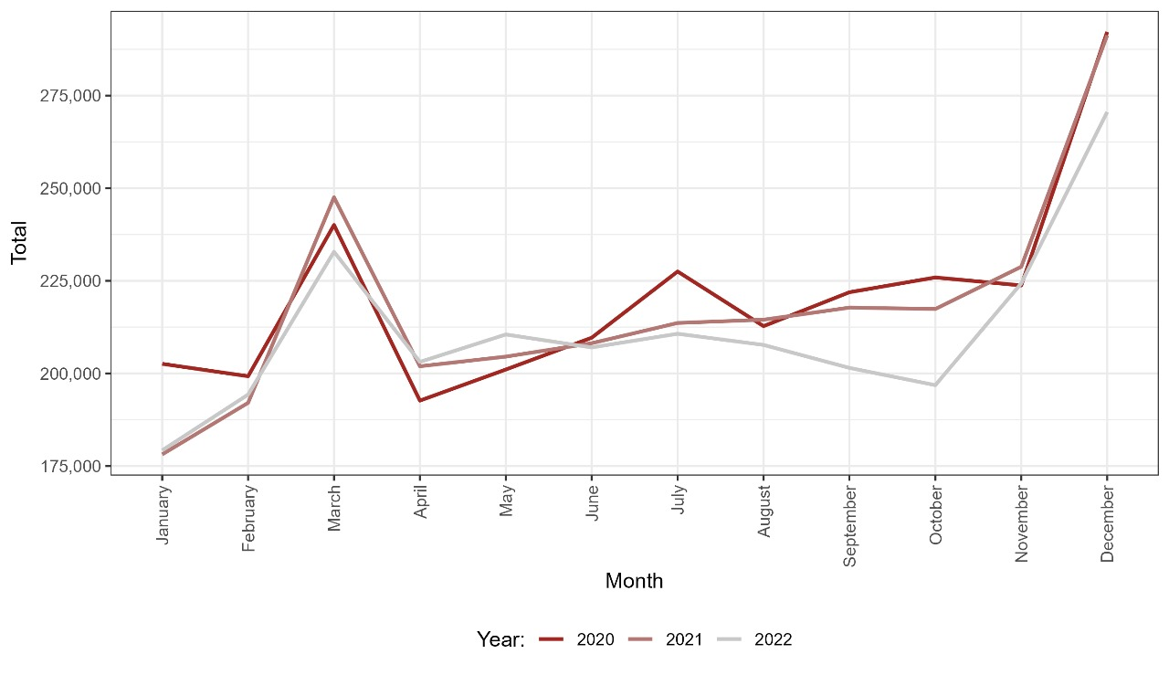
SLAUGHTER SEASONALITY

Slide 17
BEEF EXPORTS
EXPORTS PROVIDE SOME RELIEF TO SA BEEF INDUSTRY
CHALLENGES
Rise in feed prices since 2020
COVID-19 Pandemic: financial strain on consumers
Demand for red meat declined
Foot-and-mouth disease: Spreading to 6 provinces for the first time in history
The feed prices have now softened somewhat

Slide 18
BEEF EXPORTS
Despite the foot-and-mouth disease challenge, South African beef exports did not collapse.
BEEF EXPORTS 2022 28 422 tons
Fresh beef 54% | Frozen Beef 46%
Within this total figure, a significant decline was recorded in frozen beef exports, which were 12 945 tons in 2022, down 24% year-on-year. Meanwhile, fresh beef exports increased by 2% year-on-year to 15 477 tons.

Slide 19
RESIDUE MONITORING
DALRRD provides a National Chemical Residue Monitoring Programme (NCRMP) to verify compliance with the aspects of meat safety under the Meat Safety Act.
The Red Meat Abattoir Association (RMAA) provides technical assistance to the Department for the programme.
Residue monitoring programmes at abattoirs and feedlots
Ensure production of safe and wholesome products
Enhance consumer confidence
leading to increased consumption and market demand both nationally and internationally
Expansion on the programme to align with European Union (EU) Standards is currently being considered.
Notes:
Background Information:
According to the Meat Safety Act 2000 (Act No. 40 of 2000) – Essential National Standards 11.1 (q) the use, application and presence of specified substances and residues in meat and animal products must be detected and monitored in accordance with the prescribed methods.
The abattoir owner must implement and manage/monitor their own residue control programme and take corrective measures in the cases of non-compliant results in order to prevent its reoccurrence. The Department of Agriculture, Land Reform and Rural Development (DALRRD) verifies compliance by way of the National Chemical Residue Monitoring Programme (NCRMP).
We are still in the process of having our NCRMP compliant with EU Requirements.

Slide 20
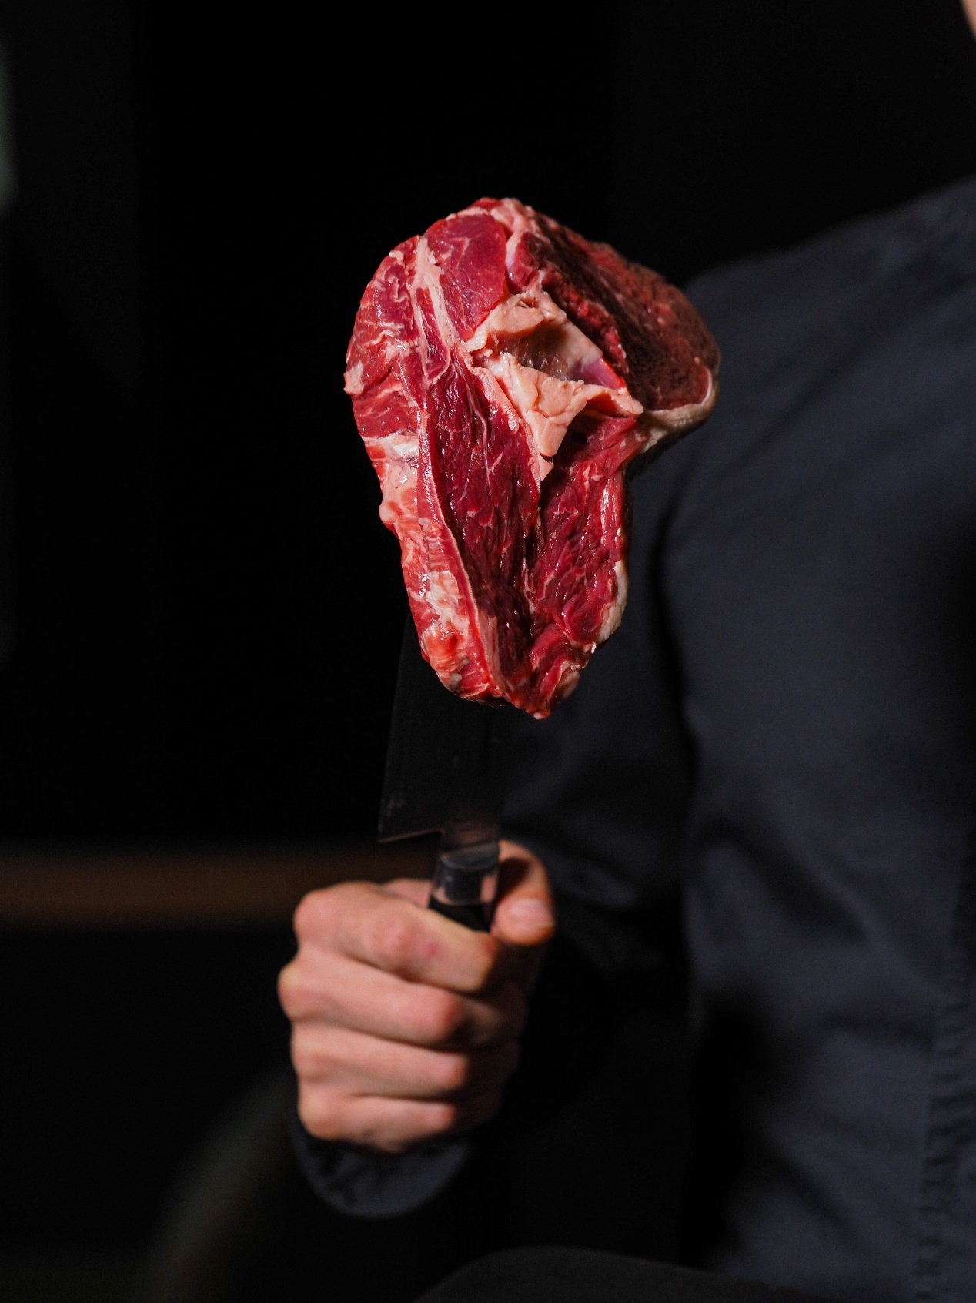
LEGAL RESPONSIBILITY
A CONSUMER PERSPECTIVE
Despite disease outbreaks and incorrect labeling
- Consumption of meat has not decreased significantly
HOWEVER: these incidents have resulted in a notable increase in consumer awareness on a global scale
IN SA: reporting and epidemiological investigation of foodborne illnesses

Slide 21
KEY MARKETS
FRESH BEEF
FROZEN BEEF
Kuwait (22%)
Jordan (16%)
Mozambique (13%)
United Arab Emirates (12%)
Qatar (9%)
Netherlands (4%)
Lesotho (3%)
Canada (3%)
Zimbabwe (3%)
Mauritius (3%)
Eswatini (2%)
Lesotho (16%)
China (14%)
Nigeria (14%)
United Arab Emirates (9%)
Mozambique (7%)
Kuwait (6%)
Egypt (5%)
Qatar (4%)
United Kingdom (3%)
Netherlands (3%)
Jordan (2%)
These markets accounted for 90% of South Africa's fresh beef exports in 2022.
These markets accounted for 82% of South Africa's frozen beef exports in 2022.

Slide 22
Thank You
Dewald Olivier
Executive Director
Red Meat Industry Services (RMIS)
dewaldo@rmis.co.za
www.rmis.co.za

