Slide 1
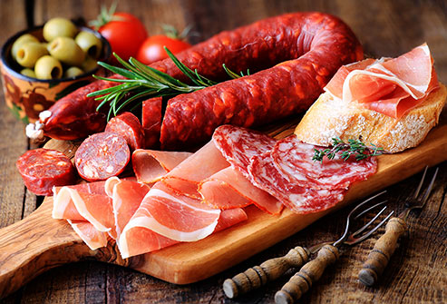
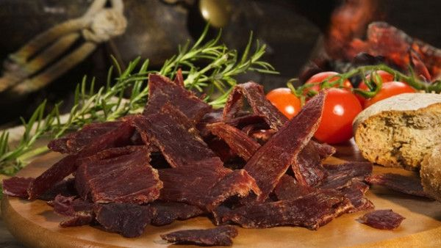
AGRICULTURAL PRODUCTS STANDARD ACT (No 119 of 1990) PROCESSED MEAT PRODUCT ASSIGNEE FEEDBACK - SAMPA’S AGM MEETNG 05 May 2021
food safety Agency pty ltd

Slide 2
Contents
Introduction
Food Safety Agency’s Foot Print
Inspection Challenges and Successors
Industry Non Compliances
Inspection Capacity Training
Inspection Process
Sampling Process (Duplication avoidance)
Laboratory Services
Way Forward
Conclusion
food safety Agency pty ltd

Slide 3
Introduction
Food Safety Agency (Pty) Ltd has been appointed as an assignee by the Department of Agriculture, Land Reform and Rural Development (DALRRD) in terms of the Agricultural Product Standards Act, 1990 (Act 119 of 1990) which includes Eggs (R.345 of 20 March 2020), Poultry Meat (R.946 of 27 March 1992) and Processed Meat Products;
The Processed Meat Regulation (R.1283) was published on 04 October 2019.
food safety Agency pty ltd

Slide 4
CONTINUATION…
The assignee was given an extension period of six (6) months to implement and roll-out the said regulation (Processed Meat Products);
Workshops, meetings and discussions with relevant industry stakeholders were held from publication up until the month of March 2020;
Inspections and sampling as per the regulation was implemented on the 1st of April 2020.
food safety Agency pty ltd

Slide 5
Foot Print
Inspected Areas April – December 2020
Processed Meat Products Manufacturers | 203
food safety Agency pty ltd

Slide 6
Inspections per commodity
Products Inspected & Sampling Conducted:
537 Products Inspected and Sampled:
April - Jul 201 Processed Meat Products August – December 336 Processed Meat Products
food safety Agency pty ltd

Slide 7
Deviations %
food safety Agency pty ltd

Slide 8
Operational matters
Summary of deviations
Labelling transgressions
No indication of country of origin on containers/packages;
Use of restricted particulars on containers;
Use of restricted particulars as part of the product name;
Inappropriate product name indicated on containers;
No indication of the manufacturer and use by date;
Compositional issues
Minimum standards for Total Meat Equivalent (TME) and fat content not met.
food safety Agency pty ltd

Slide 9
Challenges
Facilities not familiar with the published regulation;
Denial of access by facilities due to the inspection fees;
Refusal of paying the assignee for inspections conducted;
Refusal to complete the information pack prior conducting inspections;
Identification of all the processed meat products producers in South Africa, both informal and formal sectors;
Verification of recipes and/or ingredient lists not being conducted in the first year of implementation;
Industries not being truthful about the quantity of products produced;
Different governmental departments not familiar with the new processed meat product regulation;
Access and inspection denied due to Covid – 19.
food safety Agency pty ltd

Slide 10
Successors
One of the informal manufactures who refused us entry to their facility, after numerous attempts and threw our inspector out of their facility close down due to the actions taken by Food Safety Agency.
It was found that their products were not complaint to the requirements of R.1283 of 04 October 2019 in terms of composition.
A legal mandate was obtained to seize their products and upon arrival at the facility it was found that they had closed down and took all of their equipment, as there were no longer producing.
Good working relationship are created with different role players and manufacturers;
A number of inspection and sampling plans have been drawn up, approved and signed by producers and inspections and sampling is done according to these plans;
Continuous engagement from manufactures to get a clear understanding of the requirements of the applicable regulation;
food safety Agency pty ltd

Slide 11
Inspection Capacity Training
Food Safety Agency, scheduled a training session for the inspector personnel to increase their exposure to the processed meat industry:
* To broaden their spectrum of the implementation of regulations and understanding the complex processes of changing recipes, marking on containers, etc.
* To receive practical training on the production of processed meat products;
To discuss any challenges, concerns or questions, with industry;
Continuous assessment will be conducted on our inspectors to ensure uniformity and good quality standards.
CONDUCTED TRAINING TO ALL INSPECTORS RESPONSIBLE FOR PROCESSED MEAT PRODUCT INSPECTION IN THE COUNTRY
Management | 3
Inspectors | 20
food safety Agency pty ltd

Slide 12
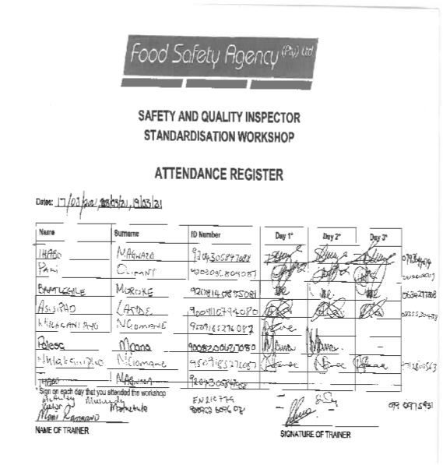
Inspection Capacity Training
food safety Agency pty ltd

Slide 13
Inspection Process
Inspections are conducted on the requirements and marking of containers;
Marking on containers can be visible on a scale label or labelling printed on the packaging;
Marking on containers must at least be in English with the following particulars:
The appropriate product name
Any additions to the product name
The name and address of the manufacturer
The date marking
Indication of the country of origin
The restricted particulars should not appear on the container, unless it is complaint to the United Kingdoms guideline.
food safety Agency pty ltd

Slide 14
Sampling Process
One product range is sampled once in 12 months;
If any discrepancies are found, the frequency of inspections & sampling increases to ensure compliance;
Inspections and sampling is done at the source;
Records are kept of inspected/sampled products;
Documentation (lab results, compliance letters etc.) is send to facilities that are inspected and sampled;
MRM analysis will be conducted if any discrepancies are found in terms of composition in products were MRM is used;
Recipe verification of products will be conducted;
The software program is in the process of being implemented in 2 months time.
food safety Agency pty ltd

Slide 15
Laboratory Services
Merieux NutriSciences
NOSA
Food Consulting Services (FCS)
SMT
SGS
KLM HIGH
food safety Agency pty ltd

Slide 16
Way Forward
Continuous engagement with the industry to educate and ensure compliance;
Continuous engagement with the Directorate: Food Safety and Quality Assurance (D: FSQA) and Directorate: Inspection Services (D: IS) for proper interpretation of legislation and external audit purposes;
To continue delivering work of good quality while empowering our inspectors with more exposure and knowledge by continuous training;
food safety Agency pty ltd

Slide 17
Conclusion
The R.1283 of 4 October 2019 is still seen as a fairly new regulation for most producers.
The enforcement and continuous inspection and sample taking will therefore ensure training from the side of Food Safety Agency to facilities in order to ensure compliance to the legislated requirements;
There has been a reduction in the number of the non-compliances in terms of composition, However more non-compliances are being identified in terms of the marking of containers;
Despite the current challenges faced, and the impact of the global pandemic on all industries, consumers still have the right to safe products of high quality and value and products that do comply to the requirements of the applicable regulations for the Republic of South Africa.
food safety Agency pty ltd

Slide 18
Continuation…
We therefore, want to thank relevant stakeholders for their continuous commitment to customer satisfaction, being compliant with the regulations and working with Food Safety Agency (Pty) Ltd to ensure high standards within the industry.
food safety Agency pty ltd

Slide 19
food safety Agency pty ltd

